Slide 1
电子邮件安全
主要内容：SMTP & POP3、MIME和PGP
电子邮件是最普及最重要，同时也最受问题困扰的互联网应用之一。

Slide 2
SNMP/POP3 E-Mail: @
SMTP: 25
RFC 821 SMTP - Simple Mail Transfer Protocol
POP3: 110
RFC 1939 POP3 - Post Office Protocol – V3
IMAP: 143
RFC 2060 Internet Message Access Protocol
allows a client to access and manipulate electronic mail messages on a server
Notes:
EDI：电子数据交换

Slide 3
E-Mail software
* Client: Outlook/Exp, Foxmail, Eudora
* Server: Sendmail, Exchange, Exim, Qmail, Postfix
SMTP Server Survey // 958 All
401 UNIX Sendmail
176 Windows Microsoft Exchange or IIS SMTP
167 UNIX qmail
57 Windows Ipswitch IMail
23 UNIX smap
15 UNIX IBM Postfix, formerly VMailer
14 UNIX Exim
12 Windows Gordano NTMail
Notes:
http://www.ohse.de/uwe/surveys/index.html http://cr.yp.to/surveys/smtpsoftware6.txt
This survey was carried out between 2001-09-27 and 2001-10-03.

Slide 4
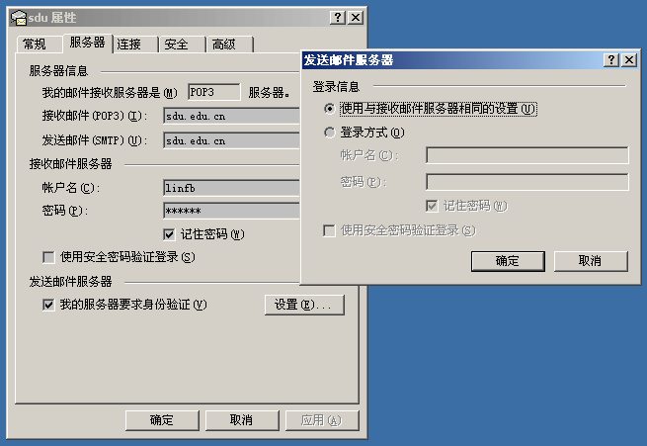
SMTP/POP3安全问题
窃听
sniffer
伪造
发信的随意性
抵赖
邮件传播病毒
垃圾邮件

Slide 5
EMAIL安全增强
PGP
S/MIME
Notes:
GPG(Gnu Privacy Guard)

Slide 6

PGP - Pretty Good Privacy
介绍
Phil Zimmermann
http://www.philzimmermann.com/ZH/
Open/Free
个人创造，流行世界，为黑白两道广泛使用
功能
邮件/文件的加密/签名
使用公钥/证书
算法
DES、3DES、CAST-128、IDEA、AES
RSA、DSS、DH

Slide 7
PRZ case dropped
PGP使用了高强度的算法、适应性强、源码公开
Philip R. Zimmermann是Pretty Good Privacy, 一个邮件加密软件的开创者. PGP 于1991年在Internet上免费的发布, 它的最初设计目标是一个保护人权的工具. 由于PGP在世界范围的传播违反了美国政府关于加密软件的出口限制, Zimmermann受到了为期三年刑事调查. 尽管缺少资金, 缺少任何付酬员工, 缺少在后面支持的一个公司, 还有着政府的烦扰, PGP仍然成为了世界上使用最为广泛的邮件加密软件. 1996年初, 在政府撤手这个案子之后, Zimmermann创立了PGP公司. 1997年12月, 公司被Network Associates Inc(NAI)收购, 在那里他做了三年的高级职员. 2002年8月, PGP被一家名叫 PGP有限公司的新公司从NAI购得, Zimmermann在那里担任特殊顾问和咨询.

Slide 8
获得PGP
下载、安装、注册
PGP Corporation
http://www.pgp.com/
The International PGP Home Page
http://www.pgpi.org/
GPG - The GNU Privacy Guard
http://www.gnupg.org/
OpenPGP
http://www.openpgp.org/
The comp.security.pgp FAQ
http://www.pgp.net/pgpnet/pgp-faq/
Notes:
PGP － Pretty Good Privacy
1. 下载、安装、注册
2. 功能
2.1 密钥管理
产生自己的RSA/DSS钥
导入别人的钥
导出钥
2.2 签名
使用自己的私钥
2.3 加密
使用对方的公钥
2.4 签名并加密
先签名，再加密
2.5 创建自解密exe文件
使用某种对称算法和口令
2.6 其他功能
磁盘加密
擦除功能
3. 内部的操作原理和规则
3.1 对称算法、公钥算法和散列函数的原理
3.2 PGP中使用密码算法的规则和标准
3.3 探究源程序
4. 资料
PKI基础
网络查询Google("PGP", "GPG")

Slide 9
使用PGP
(注册)
产生私钥
名字、email帐号、RSA/1024、有效期
口令保护
导入/导出
公钥/私钥
加密/签名
邮件
文件(+自解密exe文件)
剪贴板
虚拟磁盘分区
为了交换：用自己的私钥签名，
用别人的公钥加密
为了存储：用自己的公钥加密
（此时接收者是未来的自己）

Slide 10
邮件的认证 - 签名
发送方创建邮件报文
产生SHA-1值160比特
用RSA私钥签名，签名值放在报文前面
接收方认证来源人
用发送者的公钥解密签名，获得160比特SHA-1值
该值于明文的SHA-1值比较

Slide 11
邮件的保密性 - 加密
发送
产生(128b)随机数作为会话密钥
选择合适的算法(DES)加密报文
用RSA算法/接收者的公钥加密会话密钥，放在报文前面
接收
用自己的RSA私钥解密获得会话密钥
用会话密钥解密获得明文

Slide 12
其他
加密和签名结合
先签名, 后对称加密, 再把会话密钥用公钥保护
压缩
签名之后, 加密之前
节省带宽、增强安全强度（减少了冗余信息）
编码
BASE64

Slide 13
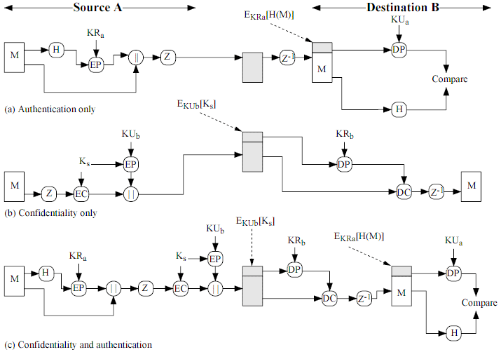
PGP中对报文的操作

Slide 14
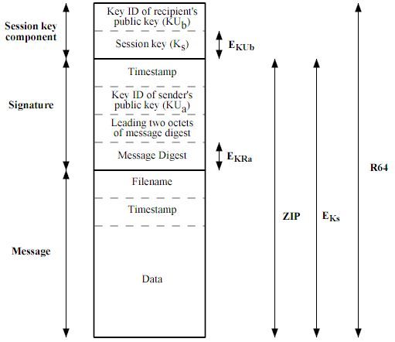
PGP报文格式

Slide 15
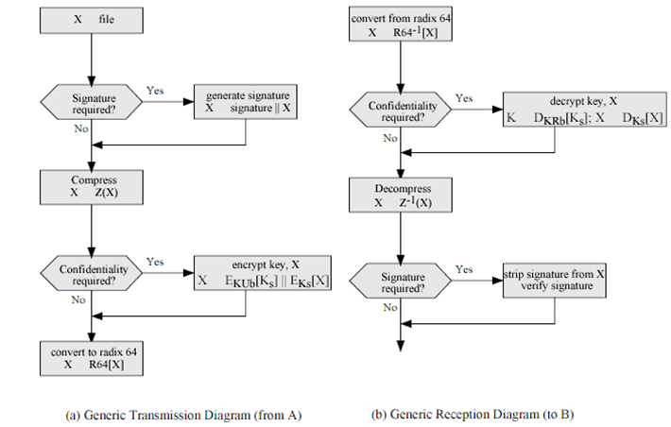
PGP中的报文传输
Notes:
Radix64 与base64编码
GP和S/MIME均使用了Radix-64编码技术，Radix-64编码基于Base64编码技术，由两部分构成。分别是Base64编码后的数据和一个校验和。

Slide 16
IP安全
主要内容：VPN、IPSec（IPSec/AH、 IPSec/ESP）

Slide 17
VPN介绍
适应场合
分布式办公环境
安全的远程访问
Intranet/Extranet
电子商务/电子数据交换EDI
优点
对应用透明
低成本、方便灵活
Notes:
http://www.vpnc.org/

Slide 18
VPN适用场合
Virtual Private Network：
使用标准的协议在不安全的公网上构建安全的隧道
保密、认证和消息完整性
专线私有网
如银行、证券、大公司分公司等专线网络
线路完全在用户自己的掌控之下，一般无加密
加密的专线网
借助公网互联的私有网
IP VPN

Slide 19
VPN类型
Trusted VPN
租用专线，相信提供商的线路的专用性可安全
能控制路径和路由
Secure VPN
使用互联网线路，在网络边缘加解密
不担心如何路由
Hybrid VPN
在Trusted VPN基础之上的混合模式

Slide 20
VPN技术
PPTP/L2TP:
SSL VPN: 主要是基于Web的客户，这些Web应用目前主要是内部网页游览、电子邮件及其它基于Web的查询工作。
IPSec VPN是基于IPSec协议的VPN产品，由IPSec协议提供隧道安全保障。IPSec是一种由IETF设计的端到端的确保基于IP通讯的数据安全性的机制。IPSEC支持对数据加密，同时确保数据的完整性。
OpenSSH VPN
Notes:
关于pptp/l2tp:
http://blog.163.com/hlz_2599/blog/static/142378474201341511122929/

Slide 21
IP安全性
加密、完整性认证、来源认证、抗重放
IPSec的优点：
当防火墙或路由器使用IPSec时，能对通过其边界的所有通信提供强安全保障
位于传输层之下的IPSec对于所有应用都是透明的
IPSec对于终端用户透明
…
Notes:
IPSec协议介绍：
http://blog.csdn.net/tantexian/article/details/43448499

Slide 22
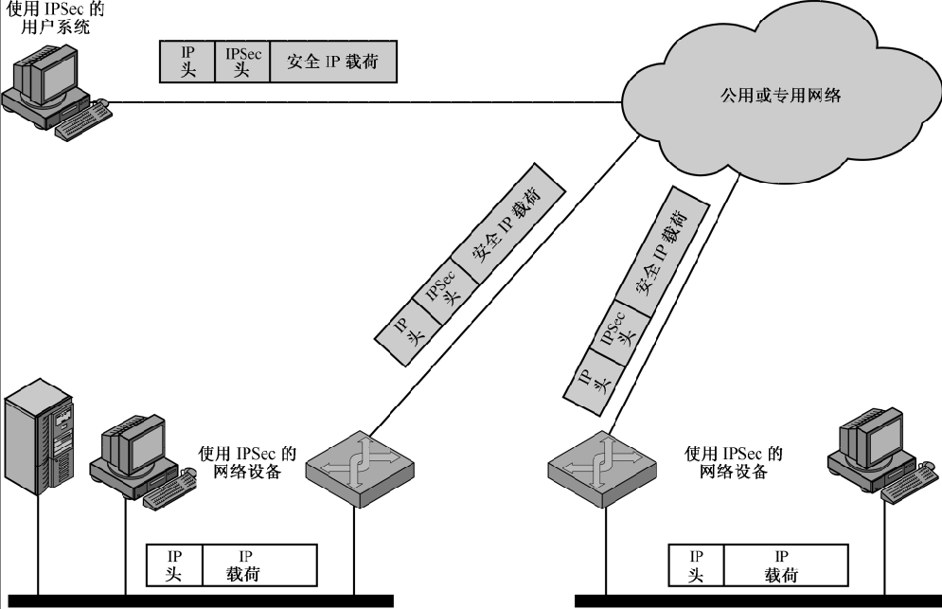
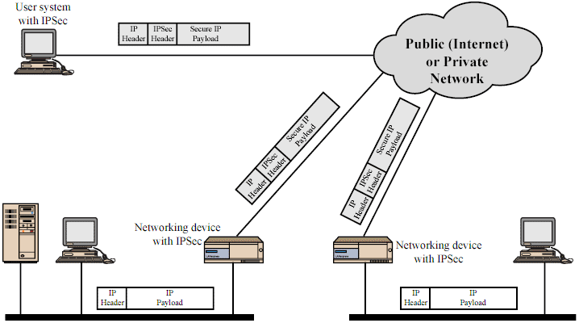
IPSec应用示意图
防火墙或路由器
防火墙或路由器

Slide 23
IPSec规范
rfc2401 体系结构
Security Architecture for the Internet Protocol
rfc2402 鉴别首部 AH
Authentication Header
rfc2406 封装安全有效载荷 ESP
Encapsulating Security Payload
rfc2409 密钥管理 The Internet Key Exchange (IKE)
密码算法：加密、认证、随机数、密钥交换、散列等密码算法
DES 3DES DH MD5 SHA1 RSA HMAC
Notes:
IP Security Protocol (ipsec)’ RFC
http://www.ietf.org/html.charters/ipsec-charter.html

Slide 24
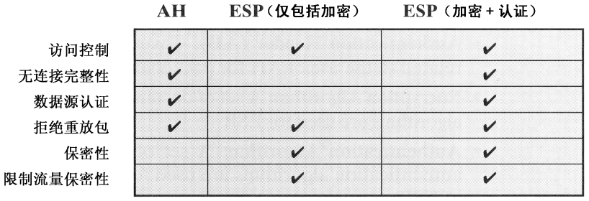
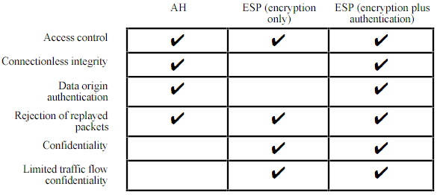
IPSec协议-服务
Limited traffic –flow confidentiality
Notes:
访问控制：对资源行使访问控制的各种机制
无连接完整性：保护单个数据块里的所有用户数据
连接完整性：包含一次连接中的所有用户数据
数据源认证：连接传输时保证收到的信息来源是声称的来源
限制流量保密性：

Slide 25
两种工作模式
隧道方式
加密整个IP分组，并放在一个新的IP分组的有效载荷部分
两个LAN通过VPN网关连接的情况
路由器或防火墙
一定的防通信量分析能力
传输方式/运输模式
只加密有效载荷部分，不加密地址等头部分
用于两个机器之间直接连接的情况
比如远程拨入方式

Slide 26
安全关联
安全关联SA - Security Association
发送方→接收方的单向关联
收发双方协商好的安全相关参数
用于AH或ESP
SPI 本地参数表的索引号
计数器、防重放窗口、生存期
AH信息、ESP信息
隧道 or 传输方式
IP目的地址
协议标识

Slide 27
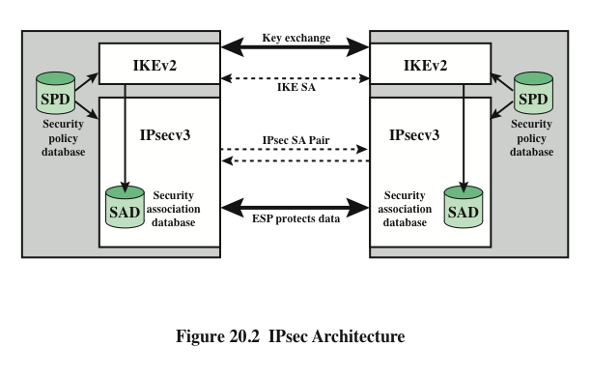

Slide 28
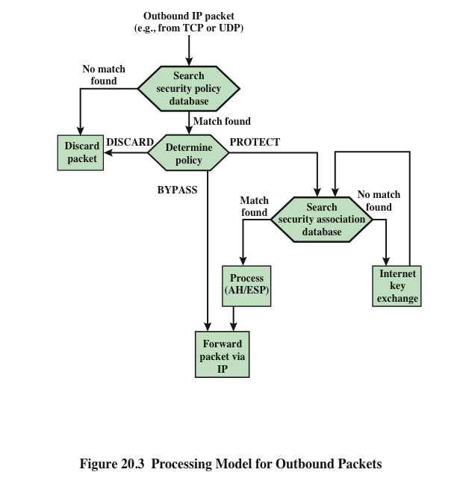
Notes:
Figure 20.3 highlights the main elements of IPsec processing
for outbound traffic. A block of data from a higher layer, such as TCP, is passed
down to the IP layer and an IP packet is formed, consisting of an IP header and an
IP body. Then the following steps occur:
1. IPsec searches the SPD for a match to this packet.
2. If no match is found, then the packet is discarded and an error message is
generated.
3. If a match is found, further processing is determined by the first matching
entry in the SPD. If the policy for this packet is DISCARD, then the packet is
discarded. If the policy is BYPASS, then there is no further IPsec processing;
the packet is forwarded to the network for transmission.
4. If the policy is PROTECT, then a search is made of the SAD for a matching
entry. If no entry is found, then IKE is invoked to create an SA with the appropriate
keys and an entry is made in the SA.
5. The matching entry in the SAD determines the processing for this packet.
Either encryption, authentication, or both can be performed, and either transport
or tunnel mode can be used. The packet is then forwarded to the network
for transmission.

Slide 29
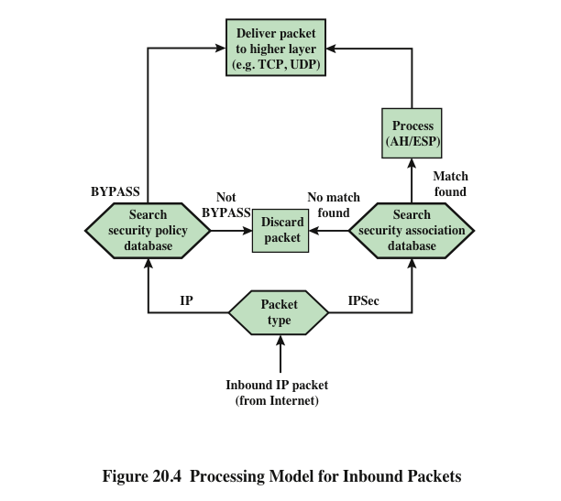
Notes:
Figure 20.4 highlights the main elements of IPsec processing for
inbound traffic. An incoming IP packet triggers the IPsec processing.

Slide 30
IPSec/AH认证头部
AH提供的服务
AH头结构
模式

Slide 31
AH提供的服务
提供认证服务
检测传输过程中的改变
发现地址欺骗攻击
杜绝重放攻击 (序列号的宽度问题)
相应的技术手段
HMAC-MD5/SHA1，但是只是用前96比特
序号

Slide 32
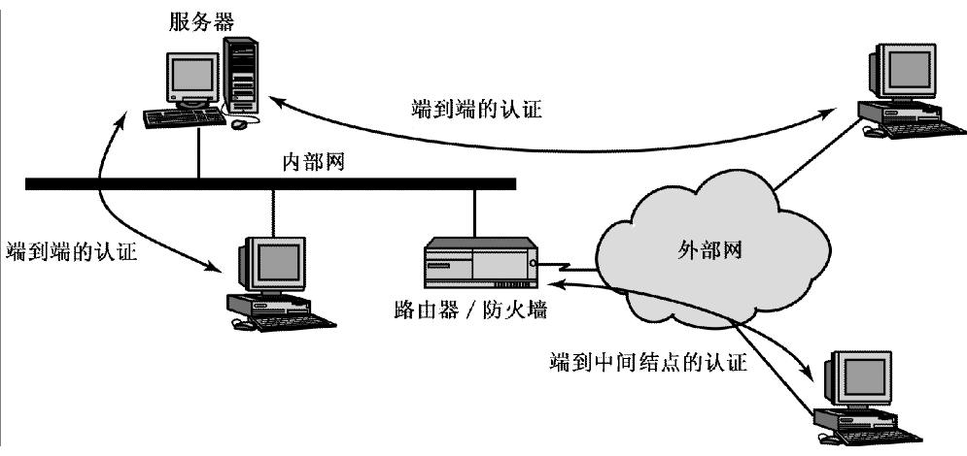
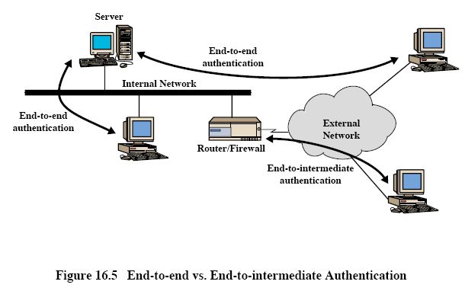
AH

Slide 33
AH
on IPv4
IP+TCP+DATA
IP+AH+TCP+DATA (transport)
NewIP+AH+IP+TCP+DATA (tunnel)
on IPv6
* in RFC 2402

Slide 34
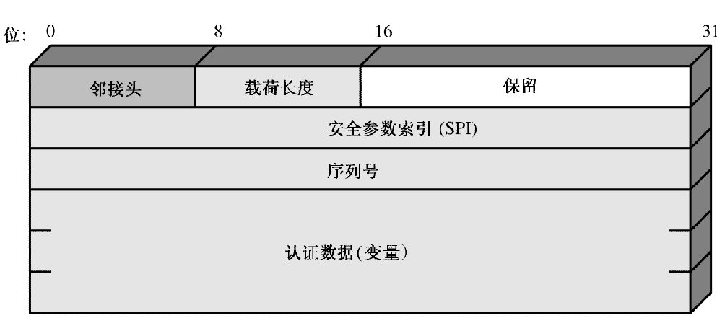
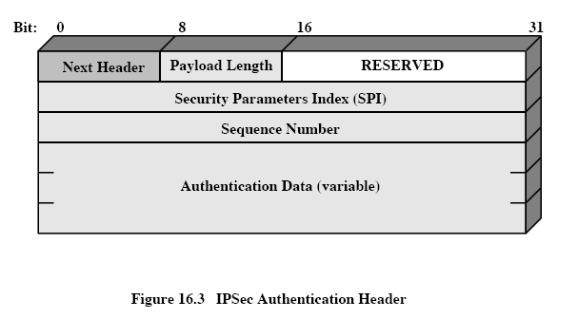
AH

Slide 35
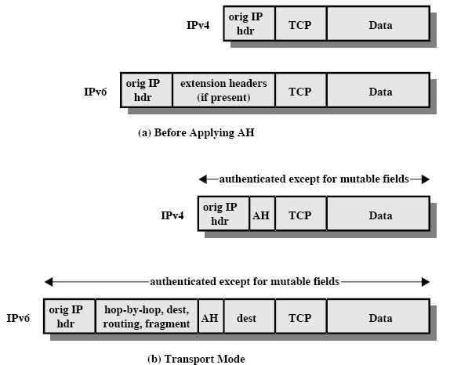
AH – 传输模式

Slide 36


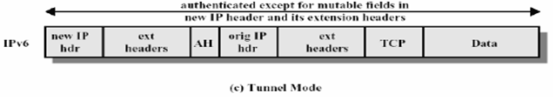

AH – 隧道模式

Slide 37
IPSec/ESP封装安全性有效载荷
ESP服务
ESP模式

Slide 38
ESP提供的服务
机密性服务
对(至少)数据部分加密
填充
算法
3DES、RC5、IDEA、CAST、Blowfish

Slide 39
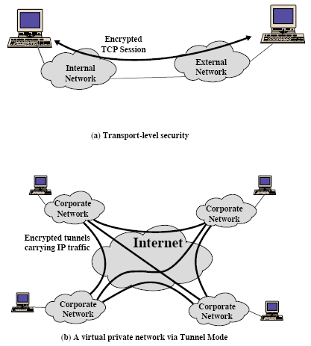
ESP

Slide 40
ESP
on IPv4
IP+TCP+DATA
IP+ESPhdr+TCP+DATA+ESPtl+ESPauth
NewIP+ESPhdr+IP+TCP+DATA+ESPtl+ESPauth
on IPv6
* in RFC 2406

Slide 41
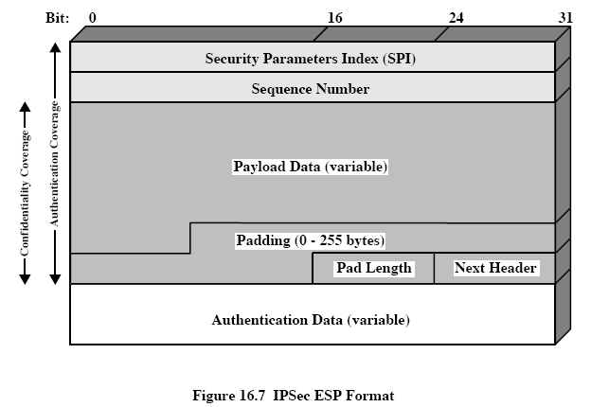
ESP

Slide 42
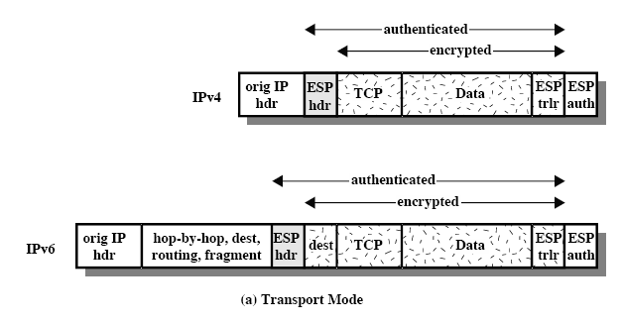
ESP – 传输模式

Slide 43
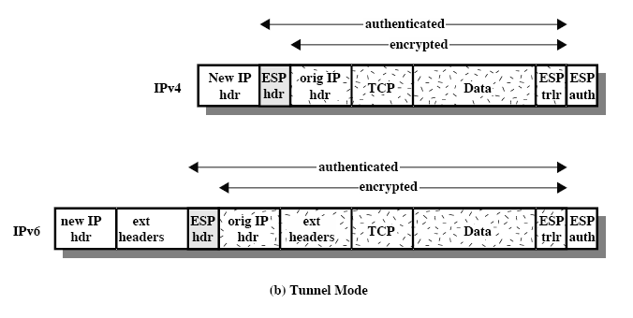
ESP – 隧道模式

Slide 44
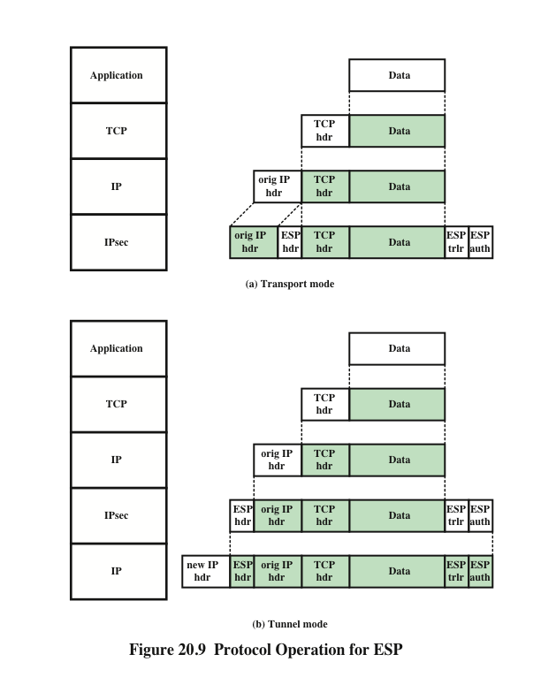
Notes:
Figure 20.9 shows the protocol architecture for the two modes.

Slide 45
小结
互联网上的安全，从VPN到SSL，从PGP到SET，都和PKI体系密切相关。
IPSec是IPv6的一部分。
IPSec因太过复杂而其安全性受质疑。
OpenVPN值得推荐。

Slide 46
无线网络安全
无线网络安全：安全无线传输、安全无线接入点、安全无线网络
移动设备安全

Slide 47
Wireless Security
与有线网络相比：无线网络面临如下安全问题：
无线网络同时是广播网络，所以更可能受到窃听和干扰
无线网络对针对通信协议漏洞的主动攻击更脆弱
无线设备移动性更强
移动性导致更多的风险
资源
智能手机平板电脑的操作系统复杂，但是内存和处理资源有限，很难对抗拒绝服务攻击和恶意软件
像传感器、机器人这样的无线设备可能会在远程或者敌对的环境中，这使得它们易受物理攻击
信道
移动性
易接近性
Notes:
Wireless networks, and the wireless devices that use them, introduce a host of security
problems over and above those found in wired networks. Some of the key factors
contributing to the higher security risk of wireless networks compared to wired
networks include the following [MA10]:
• Channel: Wireless networking typically involves broadcast communications,
which is far more susceptible to eavesdropping and jamming than wired networks.
Wireless networks are also more vulnerable to active attacks that exploit
vulnerabilities in communications protocols.
• Mobility: Wireless devices are, in principal and usually in practice, far more
portable and mobile than wired devices. This mobility results in a number of
risks, described subsequently.
• Resources: Some wireless devices, such as smartphones and tablets, have sophisticated
operating systems but limited memory and processing resources
with which to counter threats, including denial of service and malware.
• Accessibility: Some wireless devices, such as sensors and robots, may be left
unattended in remote and/or hostile locations. This greatly increases their vulnerability
to physical attacks.

Slide 48
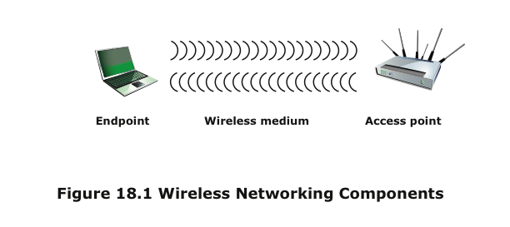
Notes:
In simple terms, the wireless environment consists of three components that
provide point of attack (Figure 18.1). The wireless client can be a cell phone, a
Wi-Fi–enabled laptop or tablet, a wireless sensor, a Bluetooth device, and so on.
The wireless access point provides a connection to the network or service. Examples
of access points are cell towers, Wi-Fi hotspots, and wireless access points to wired
local or wide area networks. The transmission medium, which carries the radio
waves for data transfer, is also a source of vulnerability.

Slide 49
Wireless Network Threats
身份盗取(MAC欺骗)
中间人攻击
拒绝服务
这种攻击发生在当攻击者不断地攻击AP或者其他可访问的接入端口时，无线网络容易受到攻击者这种把无线流量定向到目标。
网络注入
这种攻击的目标是暴露在路由协议或者网管协议中的无线接入点。例如攻击者使用伪造的重置命令来影响路由器和交换机以降低网络性能
偶然接入/意外关联
网络范围的重叠
恶意接入/恶意关联
窃取密码接入无线ap
自组网络Ad hoc networks
自组的网络因为缺乏访问控制而出现安全威胁
非传统网络Nontraditional networks
蓝牙、读卡器、PDA都有窃听和欺骗的威胁和风险
Notes:
[CHOI08] lists the following security threats to wireless networks:
• Accidental association: Company wireless LANs or wireless access points to
wired LANs in close proximity (e.g., in the same or neighboring buildings)
may create overlapping transmission ranges. A user intending to connect to
one LAN may unintentionally lock on to a wireless access point from a neighboring
network. Although the security breach is accidental, it nevertheless exposes
resources of one LAN to the accidental user.
• Malicious association: In this situation, a wireless device is configured to appear
to be a legitimate access point, enabling the operator to steal passwords
from legitimate users and then penetrate a wired network through a legitimate
wireless access point.
• Ad hoc networks: These are peer-to-peer networks between wireless computers
with no access point between them. Such networks can pose a security
threat due to a lack of a central point of control.
• Nontraditional networks: Nontraditional networks and links, such as personal
network Bluetooth devices, barcode readers, and handheld PDAs, pose a security
risk in terms of both eavesdropping and spoofing.
• Identity theft (MAC spoofing): This occurs when an attacker is able to eavesdrop
on network traffic and identify the MAC address of a computer with
network privileges.
• Man-in-the middle attacks: This type of attack is described in Chapter 10 in
the context of the Diffie-Hellman key exchange protocol. In a broader sense,
this attack involves persuading a user and an access point to believe that they
are talking to each other when in fact the communication is going through an
intermediate attacking device. Wireless networks are particularly vulnerable
to such attacks.
• Denial of service (DoS): This type of attack is discussed in detail in Chapter 21.
In the context of a wireless network, a DoS attack occurs when an attacker
continually bombards a wireless access point or some other accessible wireless
port with various protocol messages designed to consume system resources.
The wireless environment lends itself to this type of attack, because it is so
easy for the attacker to direct multiple wireless messages at the target.
• Network injection: A network injection attack targets wireless access points
that are exposed to nonfiltered network traffic, such as routing protocol messages
or network management messages. An example of such an attack is
one in which bogus reconfiguration commands are used to affect routers and
switches to degrade network performance.

Slide 50
无线传输安全
无线传输主要的威胁是窃听、改变或插入消息，以及破坏
解决窃听问题主要用两种方法:
信令隐藏
关掉无线接入点的SSID广播
给SSID分配隐藏的名字
把信令强度降到最低，仅提供所需的覆盖范围
把无线接入点放在建筑物的内部，远离窗户和外墙
加密
对所有无线传输加密能够有效应对窃听，前提是加密密钥是安全的
Notes:
The principal threats to wireless transmission
are eavesdropping, altering or inserting messages, and disruption. To deal with
eavesdropping, two types of countermeasures are appropriate:
• Signal-hiding techniques: Organizations can take a number of measures to
make it more difficult for an attacker to locate their wireless access points,
including turning off service set identifier (SSID) broadcasting by wireless access
points; assigning cryptic names to SSIDs; reducing signal strength to the
lowest level that still provides requisite coverage; and locating wireless access
points in the interior of the building, away from windows and exterior walls.
Greater security can be achieved by the use of directional antennas and of
signal-shielding techniques.
• Encryption: Encryption of all wireless transmission is effective against eavesdropping
to the extent that the encryption keys are secured.
The use of encryption and authentication protocols is the standard method of
countering attempts to alter or insert transmissions.
The methods discussed in Chapter 21 for dealing with DoS apply to wireless
transmissions. Organizations can also reduce the risk of unintentional DoS attacks.
Site surveys can detect the existence of other devices using the same frequency
range, to help determine where to locate wireless access points. Signal strengths can
be adjusted and shielding used in an attempt to isolate a wireless environment from
competing nearby transmissions.

Slide 51
无线接入点安全
无线接入点的主要威胁在于对网络的非授权访问
阻止这种访问的方法是基于端口的网络接入控制IEEE 802.1x 标准
该标准提供设备接入局域网或无线网络的认证机制
使用802.1x能阻止非法接入AP或者其他非认证设备成为不安全的后面
Notes:
The main threat involving wireless access
points is unauthorized access to the network. The principal approach for preventing
such access is the IEEE 802.1X standard for port-based network access control. The
standard provides an authentication mechanism for devices wishing to attach to a
LAN or wireless network. The use of 802.1X can prevent rogue access points and
other unauthorized devices from becoming insecure backdoors.
Section 16.3 provides an introduction to 802.1X.

Slide 52
无线网络安全
使用加密
使用杀毒软件和防火墙
关掉SSID广播
修改路由器的默认标识
修改路由器的管理员预设口令
只允许特定的计算机接入你的无线网络
Notes:
[CHOI08] recommends the following techniques for
wireless network security:
1. Use encryption. Wireless routers are typically equipped with built-in encryption
mechanisms for router-to-router traffic.
2. Use antivirus and antispyware software, and a firewall. These facilities should
be enabled on all wireless network endpoints.
3. Turn off identifier broadcasting. Wireless routers are typically configured to
broadcast an identifying signal so that any device within range can learn of the
router’s existence. If a network is configured so that authorized devices know
the identity of routers, this capability can be disabled, so as to thwart attackers.
4. Change the identifier on your router from the default. Again, this measure
thwarts attackers who will attempt to gain access to a wireless network using
default router identifiers.
5. Change your router’s pre-set password for administration. This is another prudent
step.
6. Allow only specific computers to access your wireless network. A router can
be configured to only communicate with approved MAC addresses. Of course,
MAC addresses can be spoofed, so this is just one element of a security strategy.

Slide 53

移动设备安全
移动设备已经成为整个网络基础设施的重要组成部分
在手机广泛使用之前，网络安全已经明确定义了可信的内网和不可信的外网之间的边界
一个组织的网络必须适应以下变化：
新设备的变化
基于云的应用
去边界化
外部业务的需求
Notes:
Prior to the widespread use of smartphones, the dominant paradigm for computer
and network security in organizations was as follows. Corporate IT was tightly controlled.
User devices were typically limited to Windows PCs. Business applications
were controlled by IT and either run locally on endpoints or on physical servers
in data centers. Network security was based upon clearly defined perimeters that
separated trusted internal networks from the untrusted Internet. Today, there have
been massive changes in each of these assumptions. An organization’s networks
must accommodate the following:
• Growing use of new devices: Organizations are experiencing significant growth
in employee use of mobile devices. In many cases, employees are allowed to
use a combination of endpoint devices as part of their day-to-day activities.
• Cloud-based applications: Applications no longer run solely on physical
servers in corporate data centers. Quite the opposite, applications can run
anywhere—on traditional physical servers, on mobile virtual servers, or in the
cloud. Additionally, end users can now take advantage of a wide variety of
cloud-based applications and IT services for personal and professional use.
Facebook can be used for an employee’s personal profiles or as a component
of a corporate marketing campaign. Employees depend upon Skype to speak
with friends abroad or for legitimate business video conferencing. Dropbox
and Box can be used to distribute documents between corporate and personal
devices for mobility and user productivity.
• De-perimeterization: Given new device proliferation, application mobility,
and cloud-based consumer and corporate services, the notion of a static network
perimeter is all but gone. Now there are a multitude of network perimeters
around devices, applications, users, and data. These perimeters have also
become quite dynamic as they must adapt to various environmental conditions
such as user role, device type, server virtualization mobility, network location,
and time-of-day.
• External business requirements: The enterprise must also provide guests,
third-party contractors, and business partners network access using various
devices from a multitude of locations.
The central element in all of these changes is the mobile computing device.
Mobile devices have become an essential element for organizations as part of the
overall network infrastructure. Mobile devices such as smartphones, tablets, and
memory sticks provide increased convenience for individuals as well as the potential
for increased productivity in the workplace. Because of their widespread use and
unique characteristics, security for mobile devices is a pressing and complex issue.
In essence, an organization needs to implement a security policy through a combination
of security features built into the mobile devices and additional security controls
provided by network components that regulate the use of the mobile devices.

Slide 54
移动设备的安全威胁
缺少物理安全控制
使用不可信的移动设备
使用不可信的网络
假定移动设备和公司机构之间的网络是不可信的
使用不可信的内容
移动设备可能使用其他不可信的内容
移动设备的安全策略必须以设备可能丢失和被恶意访问的假定为基础
假定并非全都设备都是可信的
未知方创建的应用程序
移动设备上安装第三方应用程序，可能形成按照恶意软件的风险
与其他系统的交互
位置服务的使用
移动设备上的GPS可被用来获取位置信息，攻击者可能利用位置信息来判断设备和使用者的位置
除非组织控制了所有的同步设备，否则移动这边会和其他设备和云存储自动同步数据，带来引入恶意软件的风险
Notes:
Mobile devices need additional, specialized protection measures beyond those
implemented for other client devices, such as desktop and laptop devices that are
used only within the organization’s facilities and on the organization’s networks.
SP 800-14 (Guidelines for Managing and Securing Mobile Devices in the Enterprise ,
July 2012) lists seven major security concerns for mobile devices. We examine each
of these in turn.
Lack of Physical Security Controls
Mobile devices are typically under the complete
control of the user, and are used and kept in a variety of locations outside the
organization’s control, including off premises. Even if a device is required to remain
on premises, the user may move the device within the organization between secure
and nonsecured locations. Thus, theft and tampering are realistic threats.
The security policy for mobile devices must be based on the assumption that
any mobile device may be stolen or at least accessed by a malicious party. The threat
is twofold: A malicious party may attempt to recover sensitive data from the device
itself, or may use the device to gain access to the organization’s resources.
Use of Untrusted Mobile Devices
In addition to company-issued and company controlled
mobile devices, virtually all employees will have personal smartphones
and/or tablets. The organization must assume that these devices are not trustworthy.
That is, the devices may not employ encryption and either the user or a third
party may have installed a bypass to the built-in restrictions on security, operating
system use, and so on.
Use of Untrusted Networks
If a mobile device is used on premises, it can connect
to organization resources over the organization’s own in-house wireless networks.
However, for off-premises use, the user will typically access organizational
resources via Wi-Fi or cellular access to the Internet and from the Internet to the
organization. Thus, traffic that includes an off-premises segment is potentially susceptible
to eavesdropping or man-in-the-middle types of attacks. Thus, the security
policy must be based on the assumption that the networks between the mobile device
and the organization are not trustworthy.
Use of Applications Created by Unknown Parties
By design, it is easy to find
and install third-party applications on mobile devices. This poses the obvious risk of
installing malicious software. An organization has several options for dealing with
this threat, as described subsequently.
Interaction with Other Systems
A common feature found on smartphones and
tablets is the ability to automatically synchronize data, apps, contacts, photos, and
so on with other computing devices and with cloud-based storage. Unless an organization
has control of all the devices involved in synchronization, there is considerable
risk of the organization’s data being stored in an unsecured location, plus the
risk of the introduction of malware.
Use of Untrusted Content
Mobile devices may access and use content that other
computing devices do not encounter. An example is the Quick Response (QR)
code, which is a two-dimensional barcode. QR codes are designed to be captured
by a mobile device camera and used by the mobile device. The QR code translates
to a URL, so that a malicious QR code could direct the mobile device to malicious
Web sites.
Use of Location Services
The GPS capability on mobile devices can be used to
maintain a knowledge of the physical location of the device. While this feature
might be useful to an organization as part of a presence service, it creates security
risks. An attacker can use the location information to determine where the device
and user are located, which may be of use to the attacker.

Slide 55
移动设备安全策略
设备安全：密码或者PIN码保护和锁定、软件及操作系统更新、第三方应用软件的使用，同步、位置服务等
通信安全：基于加密和认证的常用机制
边界安全：应该有安全机制来保护网络不被非授权访问。如移动设备通信特制的防火墙
Notes:
自带设备BYOD

Slide 56
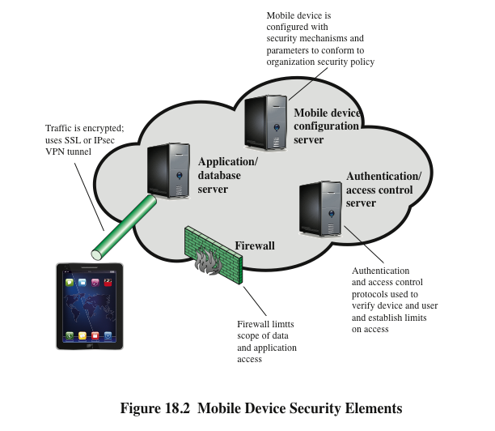
Notes:
With the threats listed in the preceding discussion in mind, we outline the principal
elements of a mobile device security strategy. They fall into three categories: device
security, client/server traffic security, and barrier security (Figure 18.2).
Device Security
A number of organizations will supply mobile devices for employee
use and preconfigure those devices to conform to the enterprise security policy.
However, many organizations will find it convenient or even necessary to adopt a bring-your-
own-device (BYOD) policy that allows the personal mobile devices of employees
to have access to corporate resources. IT managers should be able to inspect each
device before allowing network access. IT will want to establish configuration guidelines
for operating systems and applications. For example, “rooted” or “jail-broken”
devices are not permitted on the network, and mobile devices cannot store corporate
contacts on local storage. Whether a device is owned by the organization or BYOD, the
organization should configure the device with security controls, including the following:
• Enable auto-lock, which causes the device to lock if it has not been used for a
given amount of time, requiring the user to re-enter a four-digit PIN or a password
to re-activate the device.
• Enable password or PIN protection. The PIN or password is needed to unlock
the device. In addition, it can be configured so that e-mail and other data on
the device are encrypted using the PIN or password and can only be retrieved
with the PIN or password.
• Avoid using auto-complete features that remember user names or passwords.
• Enable remote wipe.
• Ensure that SSL protection is enabled, if available.
• Make sure that software, including operating systems and applications, is up
to date.
• Install antivirus software as it becomes available.
• Either sensitive data should be prohibited from storage on the mobile device
or it should be encrypted.
• IT staff should also have the ability to remotely access devices, wipe the device
of all data, and then disable the device in the event of loss or theft.
• The organization may prohibit all installation of third-party applications,
implement white-listing to prohibit installation of all unapproved applications,
or implement a secure sandbox that isolates the organization’s data and
applications from all other data and applications on the mobile device. Any
application that is on an approved list should be accompanied by a digital
signature and a public-key certificate from an approved authority.
• The organization can implement and enforce restrictions on what devices can
synchronize and on the use of cloud-based storage.
• To deal with the threat of untrusted content, security responses can include
training of personnel on the risks inherent in untrusted content and disabling
camera use on corporate mobile devices.
• To counter the threat of malicious use of location services, the security policy
can dictate that such service is disabled on all mobile devices.
Traffic Security
Traffic security is based on the usual mechanisms for encryption
and authentication. All traffic should be encrypted and travel by secure means, such
as SSL or IPv6. Virtual private networks (VPNs) can be configured so that all traffic
between the mobile device and the organization’s network is via a VPN.
A strong authentication protocol should be used to limit the access from the
device to the resources of the organization. Often, a mobile device has a single
device-specific authenticator, because it is assumed that the device has only one
user. A preferable strategy is to have a two-layer authentication mechanism, which
involves authenticating the device and then authenticating the user of the device.
Barrier Security
The organization should have security mechanisms to protect the
network from unauthorized access. The security strategy can also include firewall policies
specific to mobile device traffic. Firewall policies can limit the scope of data and
application access for all mobile devices. Similarly, intrusion detection and intrusion
prevention systems can be configured to have tighter rules for mobile device traffic.

Slide 57
IEEE 802.11 Wireless LAN Overview
IEEE 802是开发了大量的局域网标准的委员会
1990， IEEE 802成立新的工作组 IEEE 802.11, 负责开发无线局域网的协议和传输规范，满足不同频段和不同数据传输速率的无线局域网需求。
Notes:
IEEE 802 is a committee that has developed standards for a wide range of local
area networks (LANs). In 1990, the IEEE 802 Committee formed a new working
group, IEEE 802.11, with a charter to develop a protocol and transmission
specifications for wireless LANs (WLANs). Since that time, the demand for
WLANs at different frequencies and data rates has exploded. Keeping pace
with this demand, the IEEE 802.11 working group has issued an ever-expanding
list of standards.

Slide 58
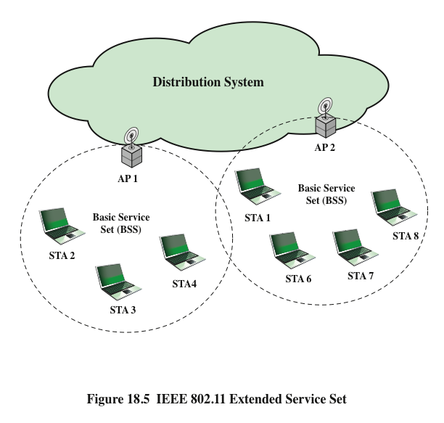
网络构成
Notes:
Figure 18.5 illustrates the model developed by the 802.11 working group. The smallest
building block of a wireless LAN is a basic service set (BSS) , which consists of
wireless stations executing the same MAC protocol and competing for access to the
same shared wireless medium. A BSS may be isolated, or it may connect to a backbone
distribution system (DS) through an access point (AP) . The AP functions as a
bridge and a relay point. In a BSS, client stations do not communicate directly with
one another. Rather, if one station in the BSS wants to communicate with another
station in the same BSS, the MAC frame is first sent from the originating station to
the AP and then from the AP to the destination station. Similarly, a MAC frame
from a station in the BSS to a remote station is sent from the local station to the AP
and then relayed by the AP over the DS on its way to the destination station. The
BSS generally corresponds to what is referred to as a cell in the literature. The DS
can be a switch, a wired network, or a wireless network.
When all the stations in the BSS are mobile stations that communicate directly
with one another (not using an AP), the BSS is called an independent BSS (IBSS) .
An IBSS is typically an ad hoc network. In an IBSS, the stations all communicate
directly, and no AP is involved.
A simple configuration is shown in Figure 18.5, in which each station belongs
to a single BSS; that is, each station is within wireless range only of other stations
within the same BSS. It is also possible for two BSSs to overlap geographically, so
that a single station could participate in more than one BSS. Furthermore, the association
between a station and a BSS is dynamic. Stations may turn off, come within
range, and go out of range.
An extended service set (ESS) consists of two or more basic service sets interconnected
by a distribution system. The extended service set appears as a single
logical LAN to the logical link control (LLC) level.

Slide 59
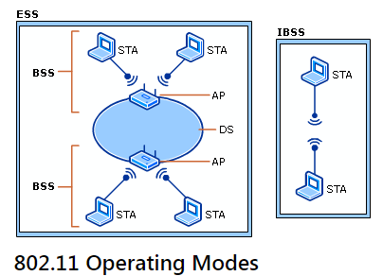
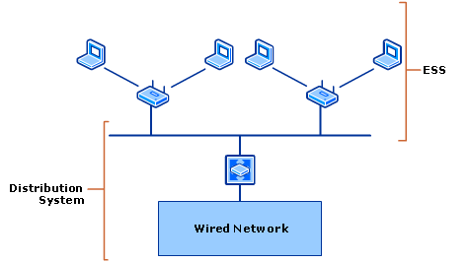

Slide 60
IEEE 802.11i Wireless LAN Security
There is an increased need for robust security services and mechanisms for wireless LANs
Wired Equivalent Privacy (WEP)
The privacy portion of the 802.11 standard
Contained major weaknesses
Wi-Fi Protected Access (WPA)
A set of security mechanisms that eliminates most 802.11 security issues
Based on the current state of the 802.11i standard
Robust Security Network (RSN)
Final form of the 802.11i standard
Complex
Notes:
http://blog.csdn.net/swjtu100/article/details/50720208
三个协议的实现
Aircrack-ng是一款用于破解无线802.11WEP及WPA-PSK加密的工具，该工具在2005年11月之前名字是Aircrack，在其2.41版本之后才改名为Aircrack-ng。
There are two characteristics of a wired LAN that are not inherent in a wireless
LAN.
1. In order to transmit over a wired LAN, a station must be physically connected
to the LAN. On the other hand, with a wireless LAN, any station within radio
range of the other devices on the LAN can transmit. In a sense, there is a form
of authentication with a wired LAN in that it requires some positive and presumably
observable action to connect a station to a wired LAN.
2. Similarly, in order to receive a transmission from a station that is part of a
wired LAN, the receiving station also must be attached to the wired LAN.
On the other hand, with a wireless LAN, any station within radio range can
receive. Thus, a wired LAN provides a degree of privacy, limiting reception of
data to stations connected to the LAN.
These differences between wired and wireless LANs suggest the increased
need for robust security services and mechanisms for wireless LANs. The original
802.11 specification included a set of security features for privacy and authentication
that were quite weak. For privacy, 802.11 defined the Wired Equivalent
Privacy (WEP) algorithm. The privacy portion of the 802.11 standard contained
major weaknesses. Subsequent to the development of WEP, the 802.11i task
group has developed a set of capabilities to address the WLAN security issues.
In order to accelerate the introduction of strong security into WLANs, the Wi-Fi
Alliance promulgated Wi-Fi Protected Access (WPA) as a Wi-Fi standard. WPA
is a set of security mechanisms that eliminates most 802.11 security issues and
was based on the current state of the 802.11i standard. The final form of the
802.11i standard is referred to as Robust Security Network (RSN) . The Wi-Fi
Alliance certifies vendors in compliance with the full 802.11i specification under
the WPA2 program.
The RSN specification is quite complex, and occupies 145 pages of the 2012
IEEE 802.11 standard. In this section, we provide an overview.

Slide 61
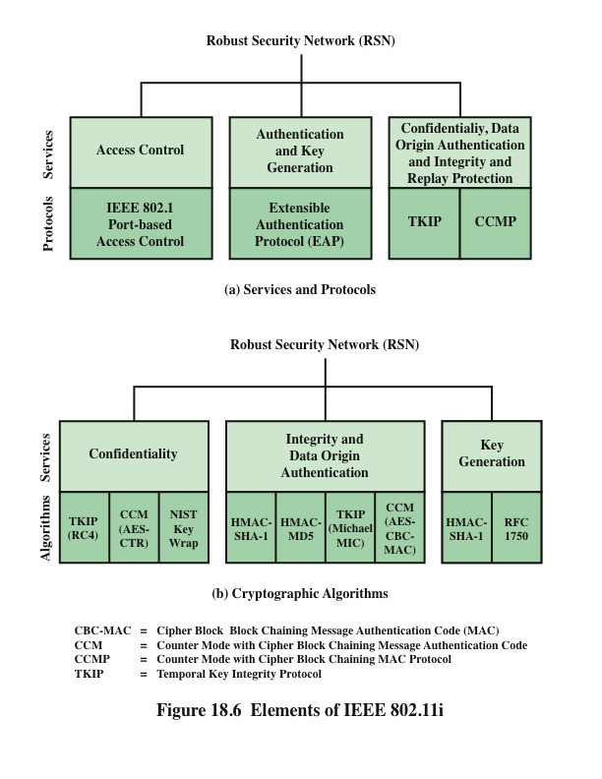
IEEE802.11i服务
IEEE 802.1XEAP
EAPOL
Notes:
The 802.11i RSN security specification defines the following services.
• Authentication: A protocol is used to define an exchange between a user and
an AS that provides mutual authentication and generates temporary keys to
be used between the client and the AP over the wireless link.
• Access control: This function enforces the use of the authentication function,
routes the messages properly, and facilitates key exchange. It can work with a
variety of authentication protocols.
• Privacy with message integrity: MAC-level data (e.g., an LLC PDU) are encrypted
along with a message integrity code that ensures that the data have
not been altered.
Figure 18.6a indicates the security protocols used to support these services,
while Figure 18.6b lists the cryptographic algorithms used for these services.

Slide 62
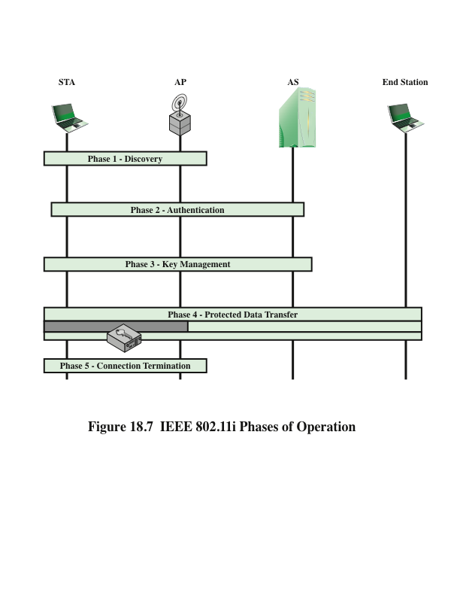
802.11i的操作过程：发现、认证、密钥生成与分发、安全数据传输、链接终止
Notes:
The operation of an IEEE 802.11i RSN can be broken down into five distinct phases
of operation. The exact nature of the phases will depend on the configuration and
the end points of the communication. Possibilities include (see Figure 18.5):
1. Two wireless stations in the same BSS communicating via the access point
(AP) for that BSS.
2. Two wireless stations (STAs) in the same ad hoc IBSS communicating directly
with each other.
3. Two wireless stations in different BSSs communicating via their respective
APs across a distribution system.
4. A wireless station communicating with an end station on a wired network via
its AP and the distribution system.
IEEE 802.11i security is concerned only with secure communication between
the STA and its AP. In case 1 in the preceding list, secure communication is assured
if each STA establishes secure communications with the AP. Case 2 is similar, with
the AP functionality residing in the STA. For case 3, security is not provided across
the distribution system at the level of IEEE 802.11, but only within each BSS. Endto-
end security (if required) must be provided at a higher layer. Similarly, in case 4,
security is only provided between the STA and its AP.
With these considerations in mind, Figure 18.7 depicts the five phases of operation
for an RSN and maps them to the network components involved. One new
component is the authentication server (AS). The rectangles indicate the exchange
of sequences of MPDUs. The five phases are defined as follows.
• Discovery: An AP uses messages called Beacons and Probe Responses to advertise
its IEEE 802.11i security policy. The STA uses these to identify an AP
for a WLAN with which it wishes to communicate. The STA associates with
the AP, which it uses to select the cipher suite and authentication mechanism
when the Beacons and Probe Responses present a choice.
• Authentication: During this phase, the STA and AS prove their identities to
each other. The AP blocks non-authentication traffic between the STA and
AS until the authentication transaction is successful. The AP does not participate
in the authentication transaction other than forwarding traffic between
the STA and AS.
• Key generation and distribution: The AP and the STA perform several operations
that cause cryptographic keys to be generated and placed on the AP and
the STA. Frames are exchanged between the AP and STA only.
• Protected data transfer: Frames are exchanged between the STA and the end
station through the AP. As denoted by the shading and the encryption module
icon, secure data transfer occurs between the STA and the AP only; security is
not provided end-to-end.
• Connection termination: The AP and STA exchange frames. During this
phase, the secure connection is torn down and the connection is restored to
the original state.

Slide 63
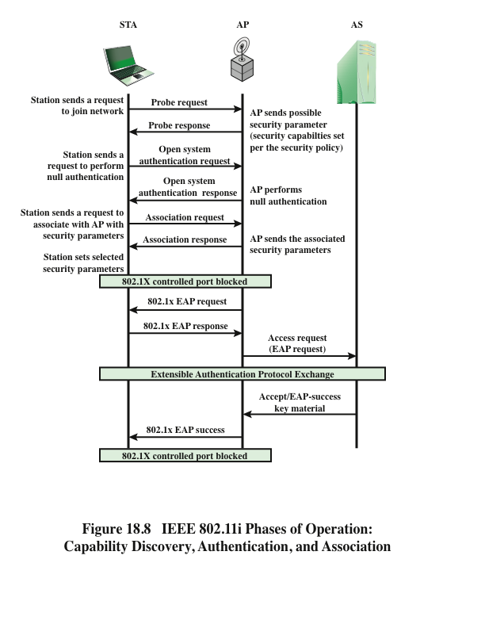
Notes:
We now look in more detail at the RSN phases of operation, beginning with the
discovery phase, which is illustrated in the upper portion of Figure 18.8. The purpose
of this phase is for an STA and an AP to recognize each other, agree on a set
of security capabilities, and establish an association for future communication using
those security capabilities.
Security Capabilities
During this phase, the STA and AP decide on specific techniques
in the following areas:
• Confidentiality and MPDU integrity protocols for protecting unicast traffic
(traffic only between this STA and AP)
• Authentication method
• Cryptography key management approach
Confidentiality and integrity protocols for protecting multicast/broadcast traffic
are dictated by the AP, since all STAs in a multicast group must use the same
protocols and ciphers. The specification of a protocol, along with the chosen key
length (if variable) is known as a cipher suite . The options for the confidentiality and
integrity cipher suite are
• WEP, with either a 40-bit or 104-bit key, which allows backward compatibility
with older IEEE 802.11 implementations
• TKIP
• CCMP
• Vendor-specific methods
The other negotiable suite is the authentication and key management (AKM)
suite, which defines (1) the means by which the AP and STA perform mutual authentication
and (2) the means for deriving a root key from which other keys may
be generated. The possible AKM suites are
• IEEE 802.1X
• Pre-shared key (no explicit authentication takes place and mutual authentication
is implied if the STA and AP share a unique secret key)
• Vendor-specific methods
The discovery phase consists of three exchanges.
• Network and security capability discovery: During this exchange, STAs discover
the existence of a network with which to communicate. The AP either
periodically broadcasts its security capabilities (not shown in figure), indicated
by RSN IE (Robust Security Network Information Element), in a specific
channel through the Beacon frame; or responds to a station’s Probe Request
through a Probe Response frame. A wireless station may discover available
access points and corresponding security capabilities by either passively monitoring
the Beacon frames or actively probing every channel.
• Open system authentication: The purpose of this frame sequence, which
provides no security, is simply to maintain backward compatibility with the
IEEE 802.11 state machine, as implemented in existing IEEE 802.11 hardware.
In essence, the two devices (STA and AP) simply exchange identifiers.
• Association: The purpose of this stage is to agree on a set of security capabilities
to be used. The STA then sends an Association Request frame to the AP.
In this frame, the STA specifies one set of matching capabilities (one
authentication and key management suite, one pairwise cipher suite, and one
group-key cipher suite) from among those advertised by the AP. If there
is no match in capabilities between the AP and the STA, the AP refuses
the Association Request. The STA blocks it too, in case it has associated
with a rogue AP or someone is inserting frames illicitly on its channel. As
shown in Figure 18.8, the IEEE 802.1X controlled ports are blocked, and no
user traffic goes beyond the AP. The concept of blocked ports is explained
subsequently.
As was mentioned, the authentication phase enables mutual authentication between
an STA and an authentication server (AS) located in the DS. Authentication
is designed to allow only authorized stations to use the network and to provide the
STA with assurance that it is communicating with a legitimate network.

Slide 64
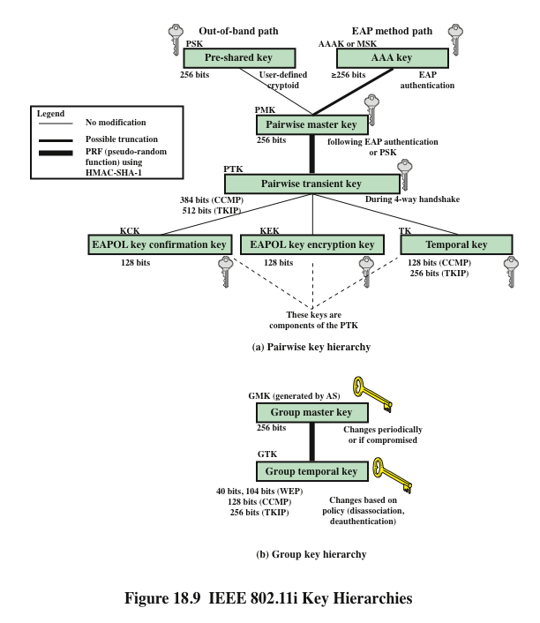
Notes:
During the key management phase, a variety of cryptographic keys are generated
and distributed to STAs. There are two types of keys: pairwise keys used for communication
between an STA and an AP and group keys used for multicast communication.
Figure 18.9, based on [FRAN07], shows the two key hierarchies.

Slide 65
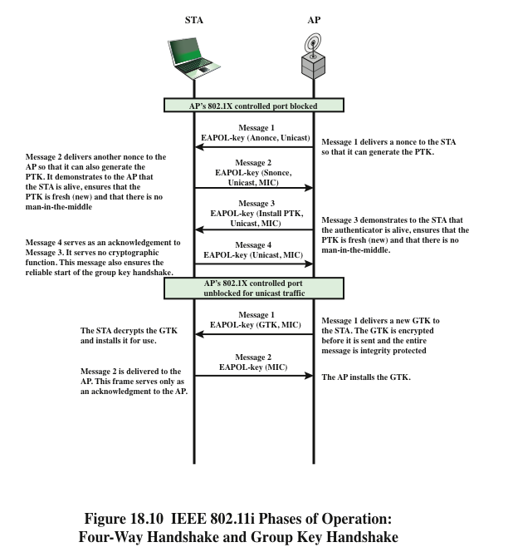
Notes:
EAP和802.1X介绍
http://book.2cto.com/201405/43281.html
hostapd wpa_supplicant madwifi详细分析（十）——wps原理及实现
http://www.2cto.com/net/201607/522072.html
The upper part of Figure 18.10 shows the MPDU
exchange
for distributing pairwise keys. This exchange is known as the 4-way handshake .
The STA and AP use this handshake to confirm the existence of the PMK,
verify the selection of the cipher suite, and derive a fresh PTK for the following data
session.

Slide 66
小节
无线网络安全、移动设备安全
IEEE 802.11WLAN
IEEE 802.11i无线网络安全
IEEE 802.11i服务
IEEE 802.11i操作阶段
发现、认证、密钥管理和安全数据传输
Notes:
Chapter 18 summary.

